Slide 1
IST 718 – Big Data Analytics 9:00pm to 10:30pm – Thursday Class Group Mamba
Group Members:
Grace Nyakwezi
Hana Kim
Bradley Coy
Allan Flores

Slide 2
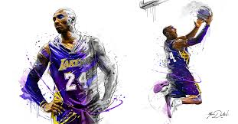
Kobe Bryant
Shot Prediction and
Financial Impact to Lakers

Slide 3
Sports analytics has become a popular topic in the data science field where the term has been popularized with the release of the 2011 film, Moneyball.
The game of sports maybe different among popular sports of baseball, hockey, football, and basketball, but the underlying principle governing the idea of analyzing and predicting outcome in sports performance is identical.
Kobe Bryant was an icon in the history of basketball and we want to leverage on data collected from his entire career.
Therefore, the team would like to get an experience in sports analytics.
Motivation

Slide 4
Using Kobe Bryant’s stats throughout 20 years of his NBA career, we want to build several models to predict whether his shot will make or miss it.
The other part of our project is to determine if there is any correlation between Kobe Bryant’s performance and the revenue and profitability of the NBA team LA Lakers using exploratory and/or Machine Learning Techniques.
Business
Questions

Slide 5
Part 1 - Analyses of shots made by Kobe Bryant (sourced from Kaggle dataset).
Part 2 – Analyses of Kobe’s performance in relation to team’s performance, revenue and profitability.
Collection of Data – 2 Parts

Slide 6
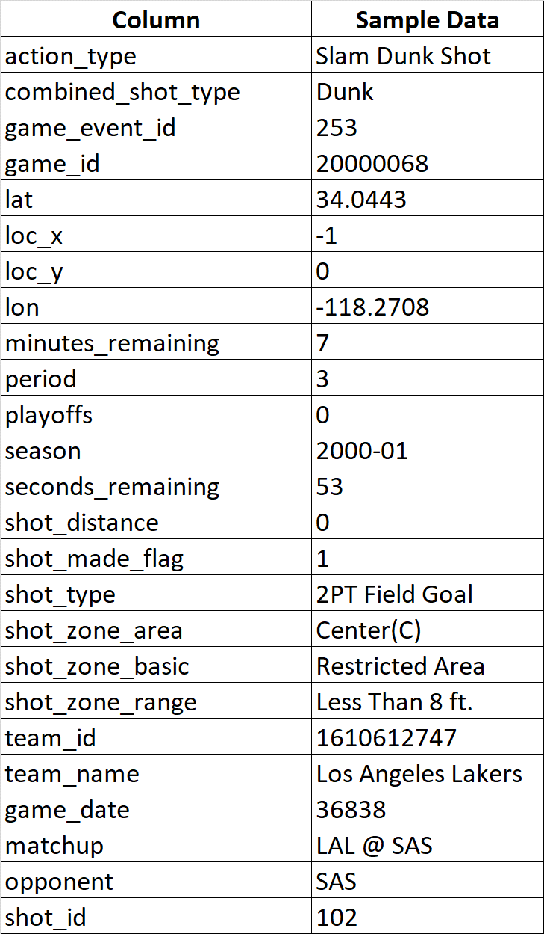
The Collection of Data – Part 1
Kobe Bryant Shot Selection Data
Primary source of dataset is from Kaggle competition titled. “Kobe Bryant Shot Selection” (https://www.kaggle.com/c/kobe-bryant-shot-selection/overview/description) for the player’s statistics.
Each of the observation represents a shot taken by Kobe Bryant over the data collection period.
Period covered from years 1996 to 2005

Slide 7
Pre-Processing and Data Cleaning – Part 1
Removed from the dataframe for column, “shot_made_flag” with null values leaving us 25,697 shots from 30,697.
This is 16% reduction from the original number of observations.
Converted game date to date time variable for future analyses.
Grouped game date at yearly level to plot the number of games per year.

Slide 8
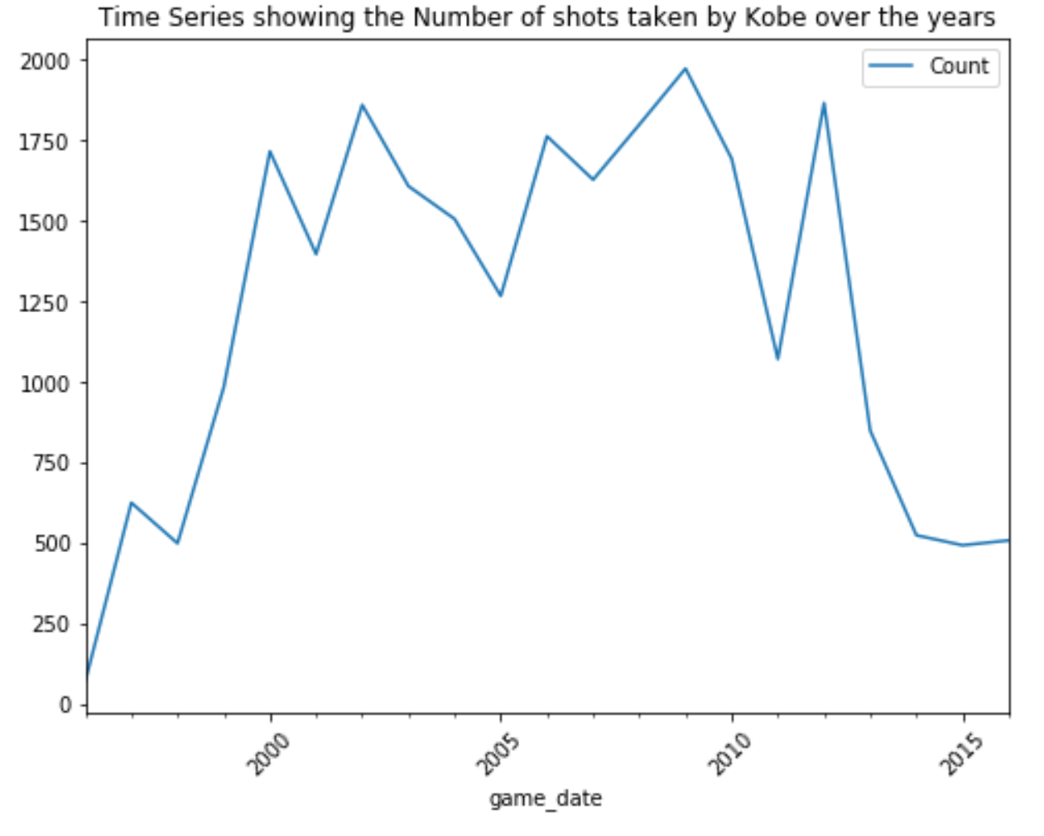
Exploring the Dataset – Part 1
There was a steady increase in the number of shots until year 2000.
His shots stabilized with some variations from years 2000 to 2011.
His shots started to decline in Y2011 until his retirement in Y2016.
It was around Y2011-12 when Kobe suffered from a torn wrist ligament.
Kobe started his career with Lakers in Y1996.
2011-12 Kobe suffered a torn wrist ligament injury.
Retirement

Slide 9
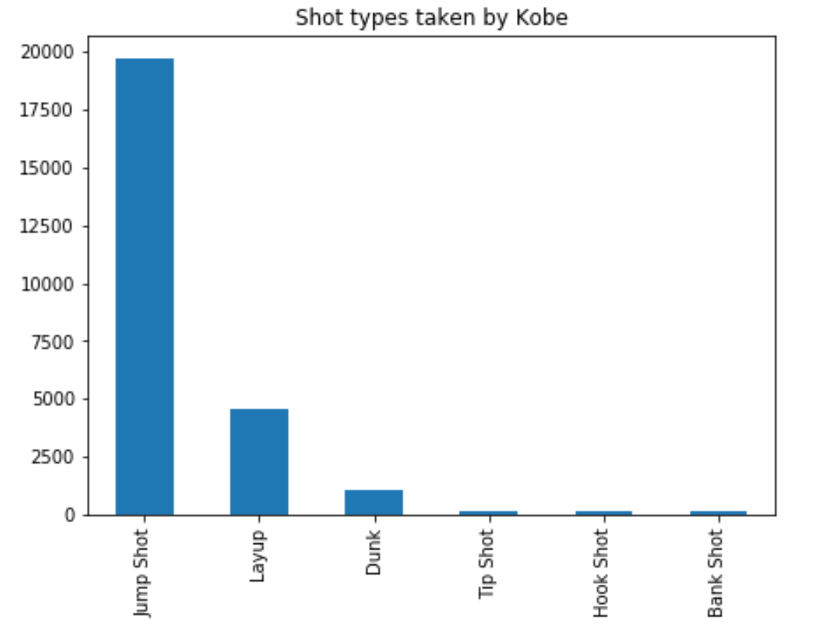
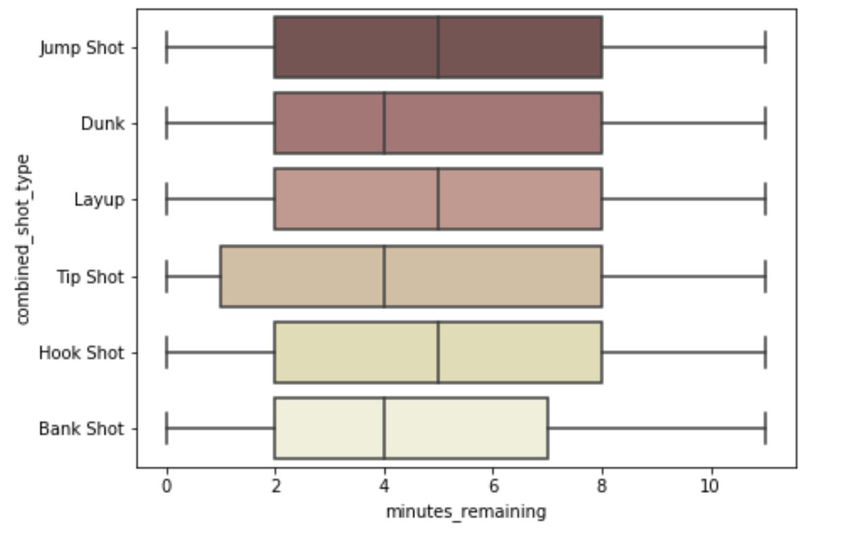
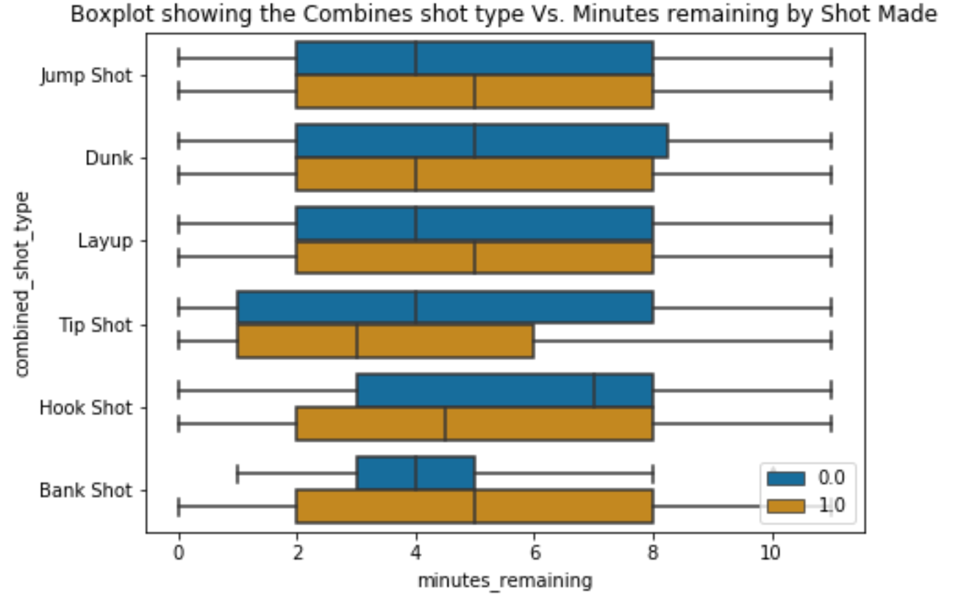
Exploring the Dataset – Part 1
Success
Failure
With 4 - 5 minutes remaining, the tip shop had the highest distribution, while bank shots had the lowest distribution.
Tip shots had the lowest median in terms of successful shots.
Kobe took different kinds of shots at an average of 4 – 5 minutes remaining. The tip shop had the highest distribution.
Majority of the shot type taken by Kobe was a jump shot.

Slide 10
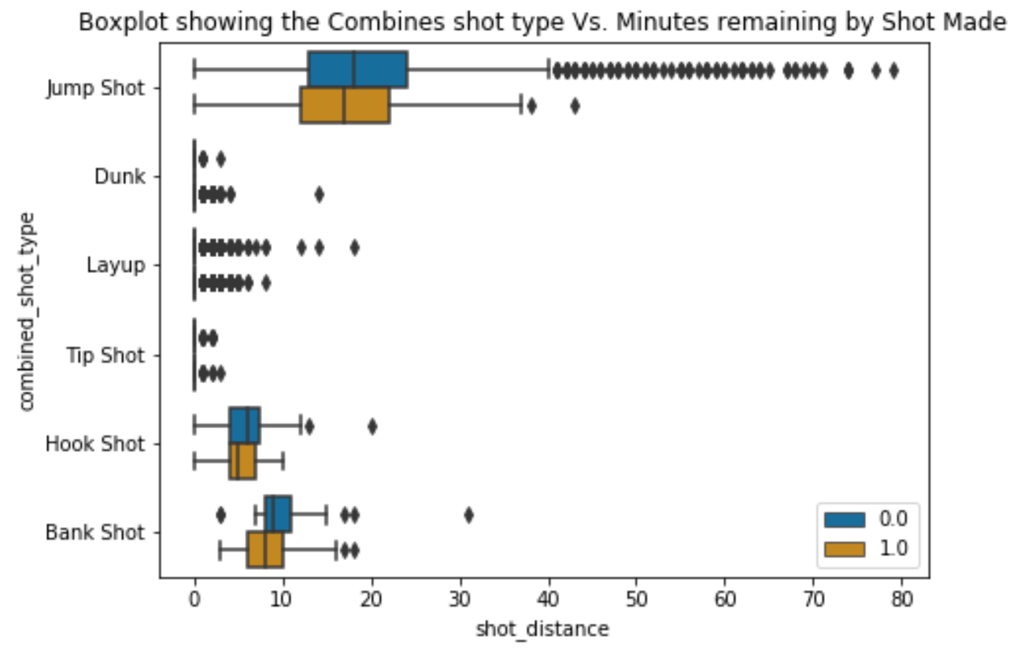
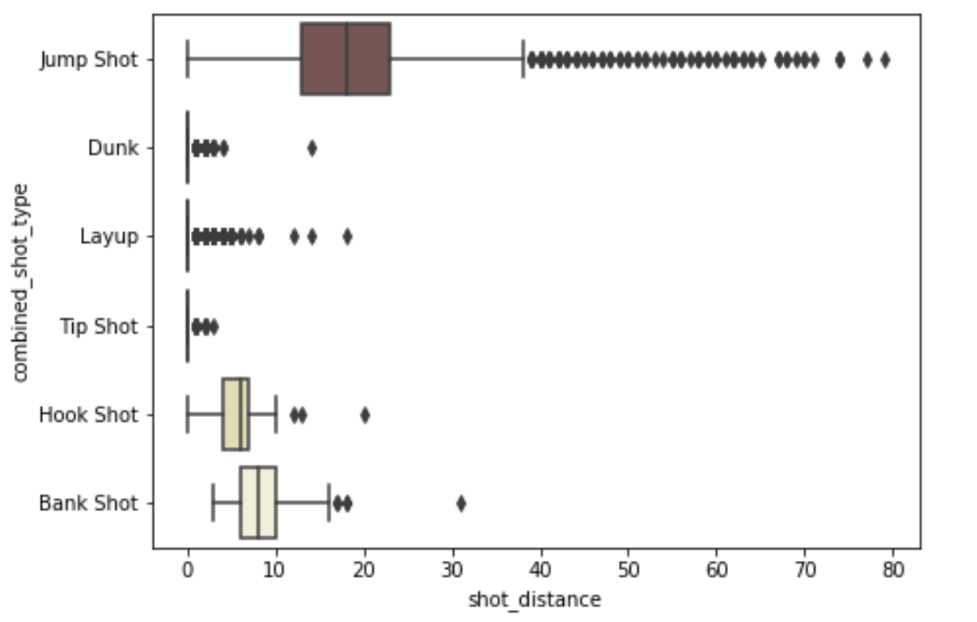
Exploring the Dataset – Part 1
Success
Failure
Jump shot had the widest distribution in terms of distance at a median of ~20 meters away from his court.
In general, the distribution of failed shots as compared to successful shots were wider except for dunk and tip shot.

Slide 11
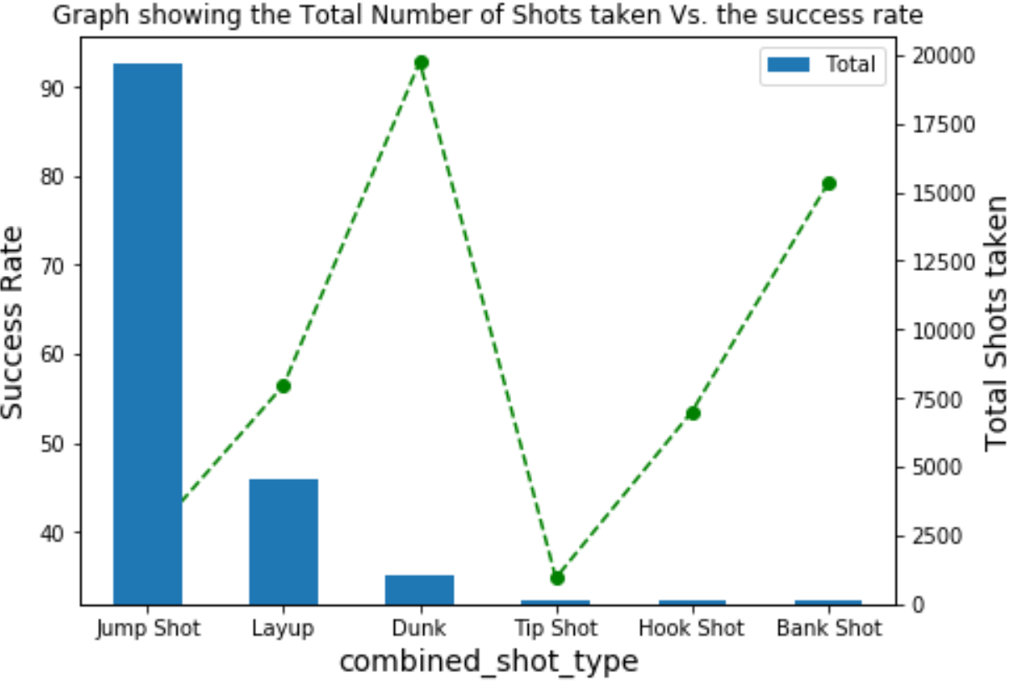
Exploring the Dataset – Part 1
93%
Jump shots with majority of the shots only had 39% success rate.
Tip shots had 34% success rate.
Dunk had the highest success rate of 93%.
39%
34%

Slide 12
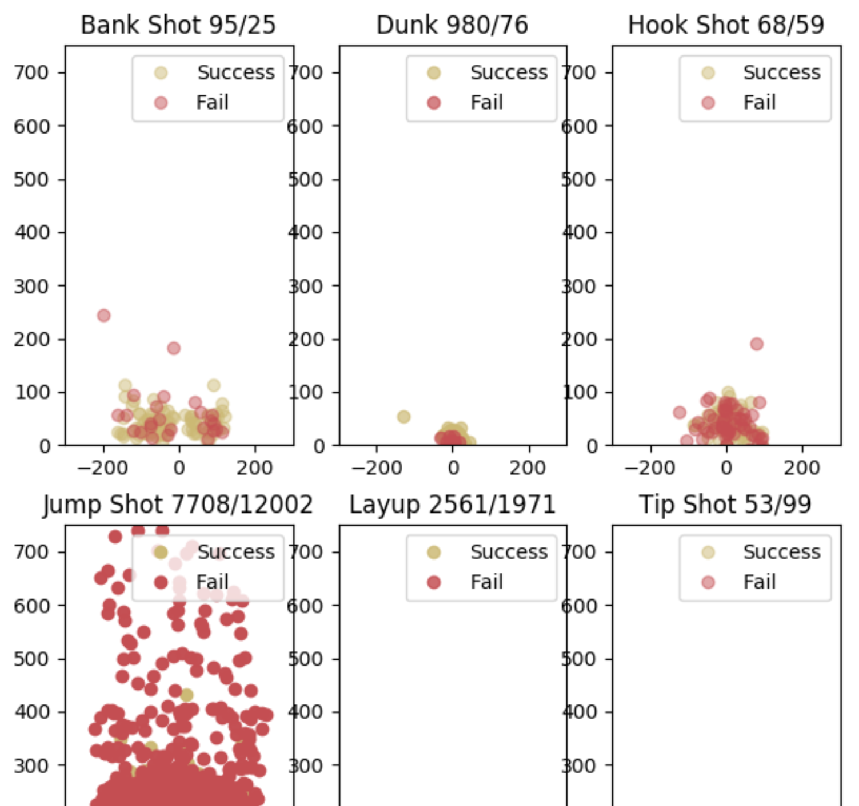
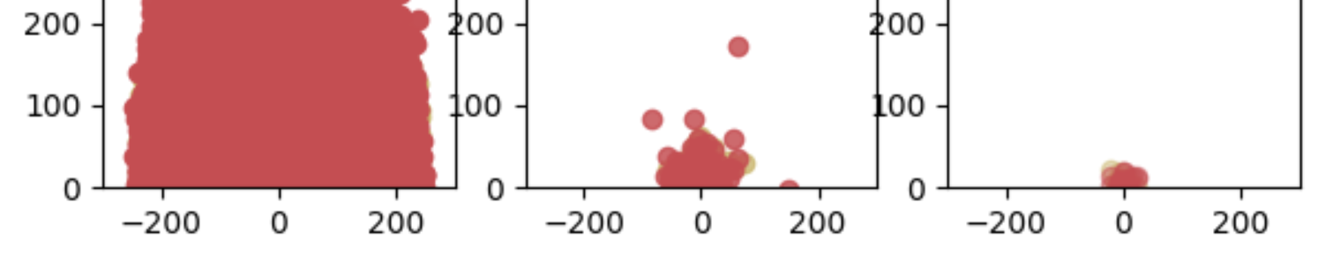
Exploring the Dataset – Part 1
More successful shots for bank shot and dunk.
Less successful for jump shot, layup, tip shot, and hook shot.

Slide 13
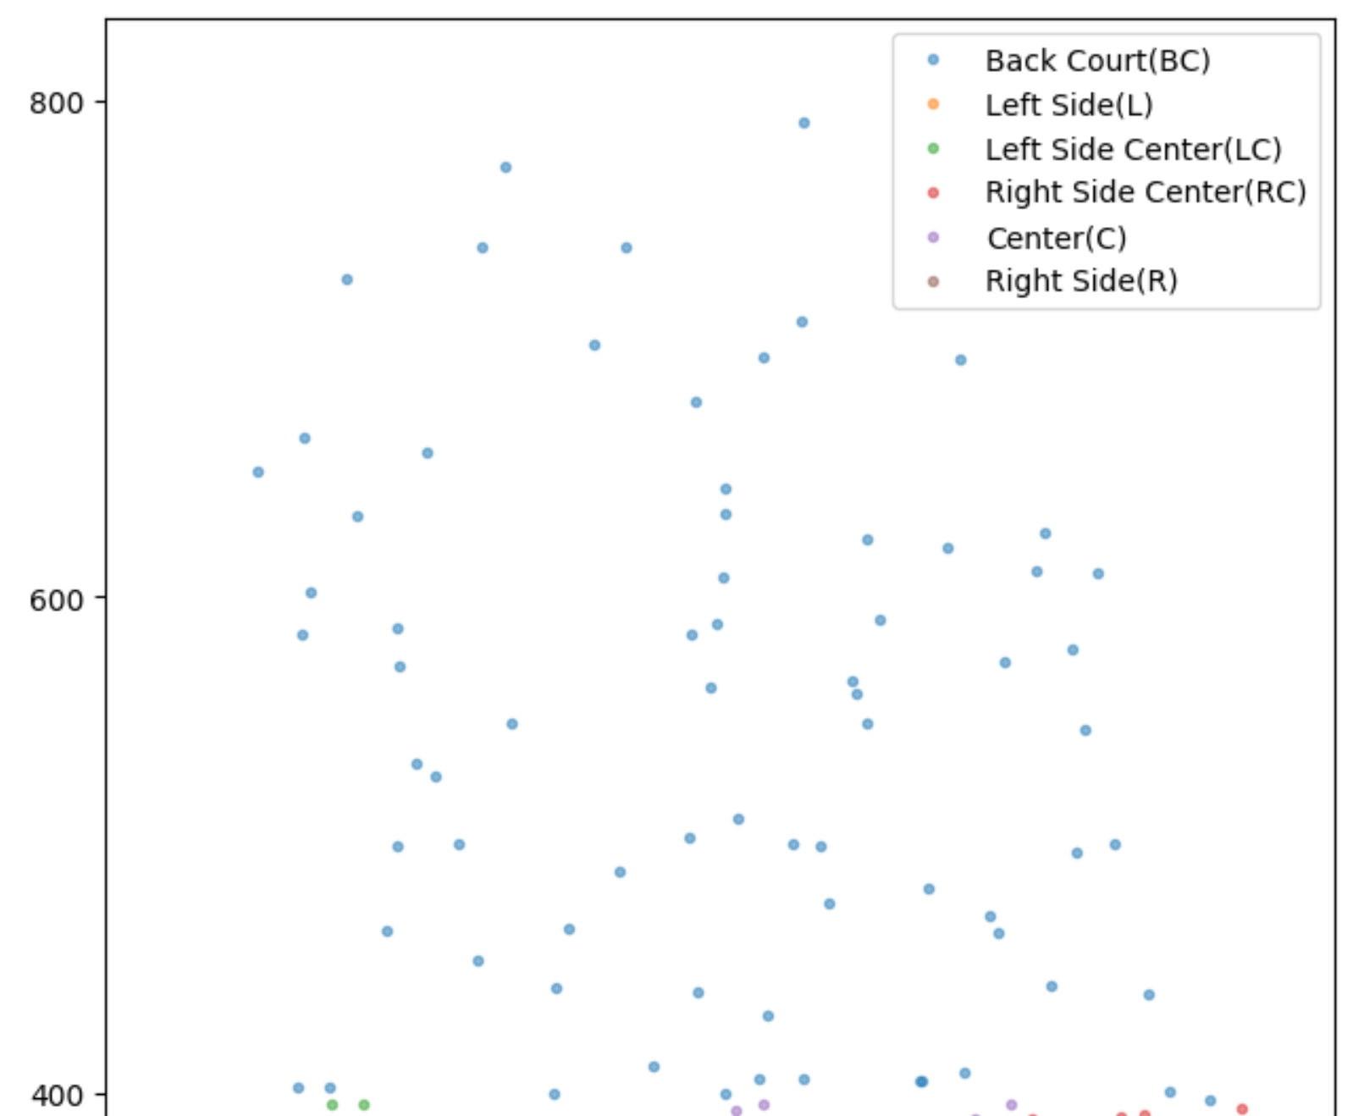
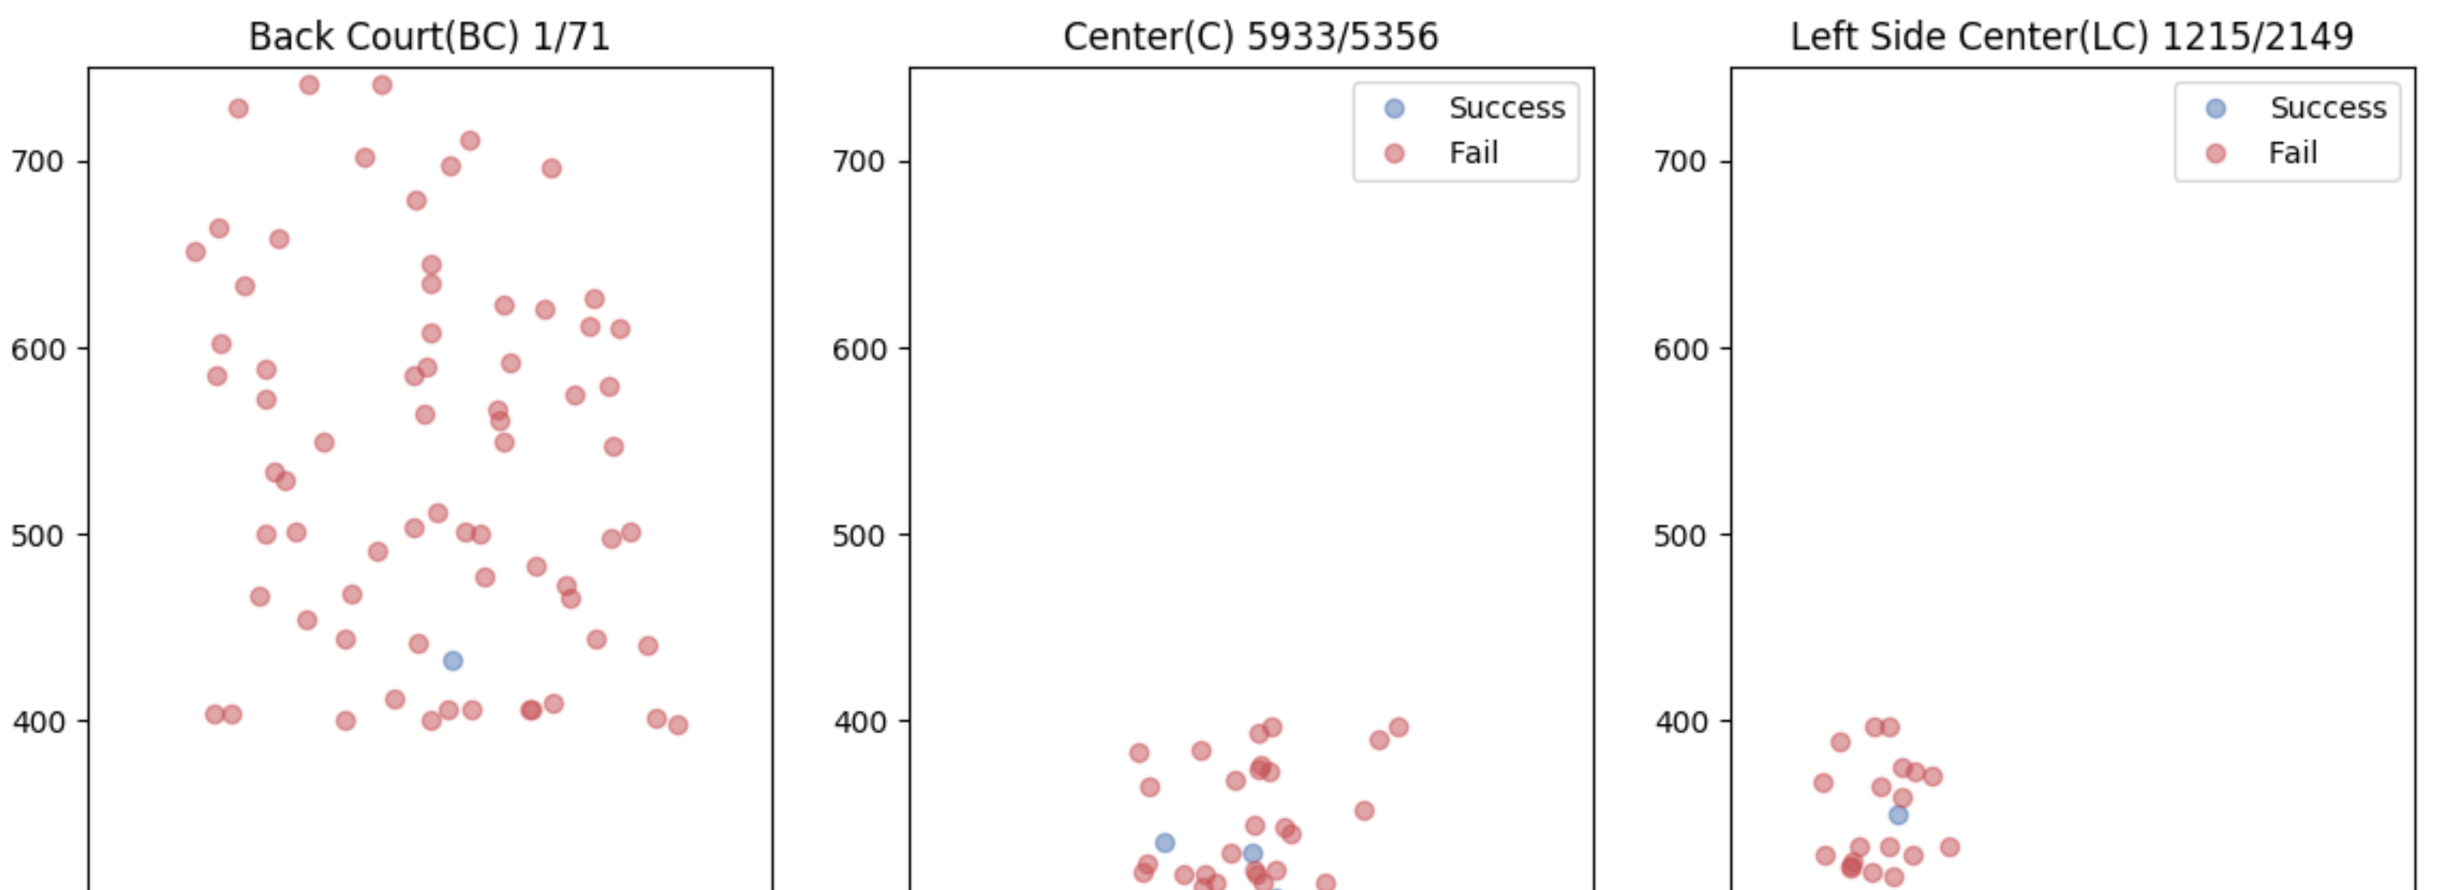
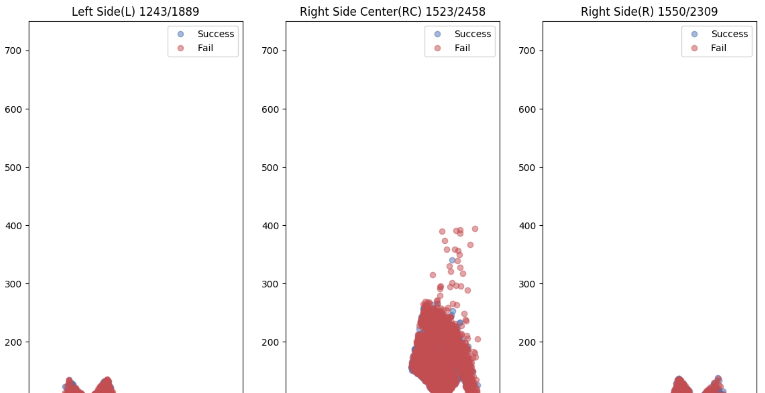
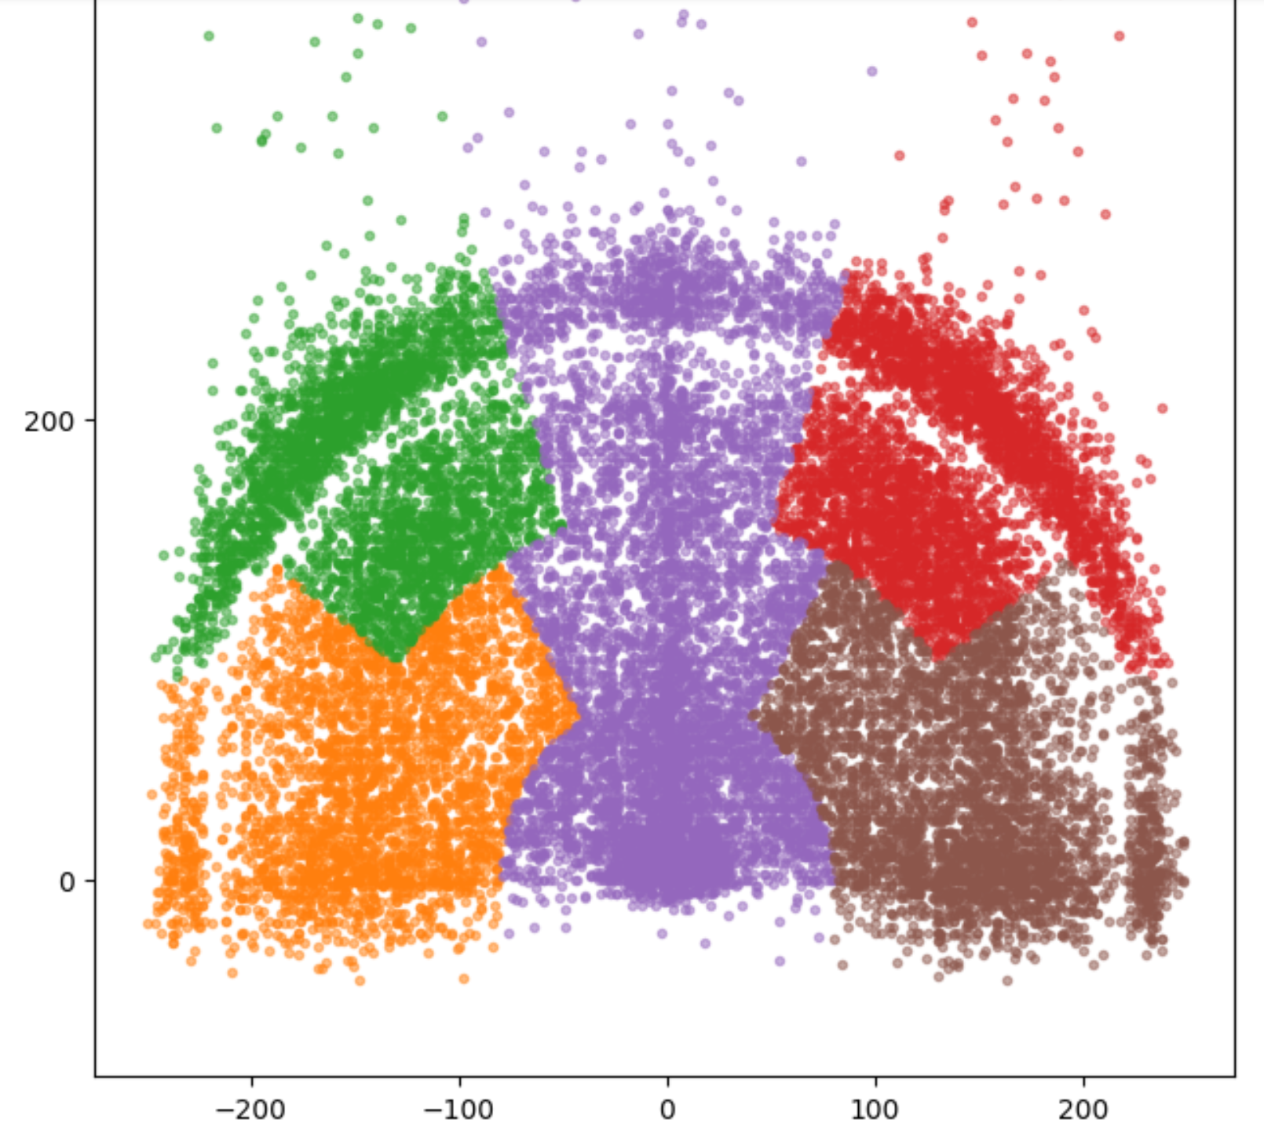
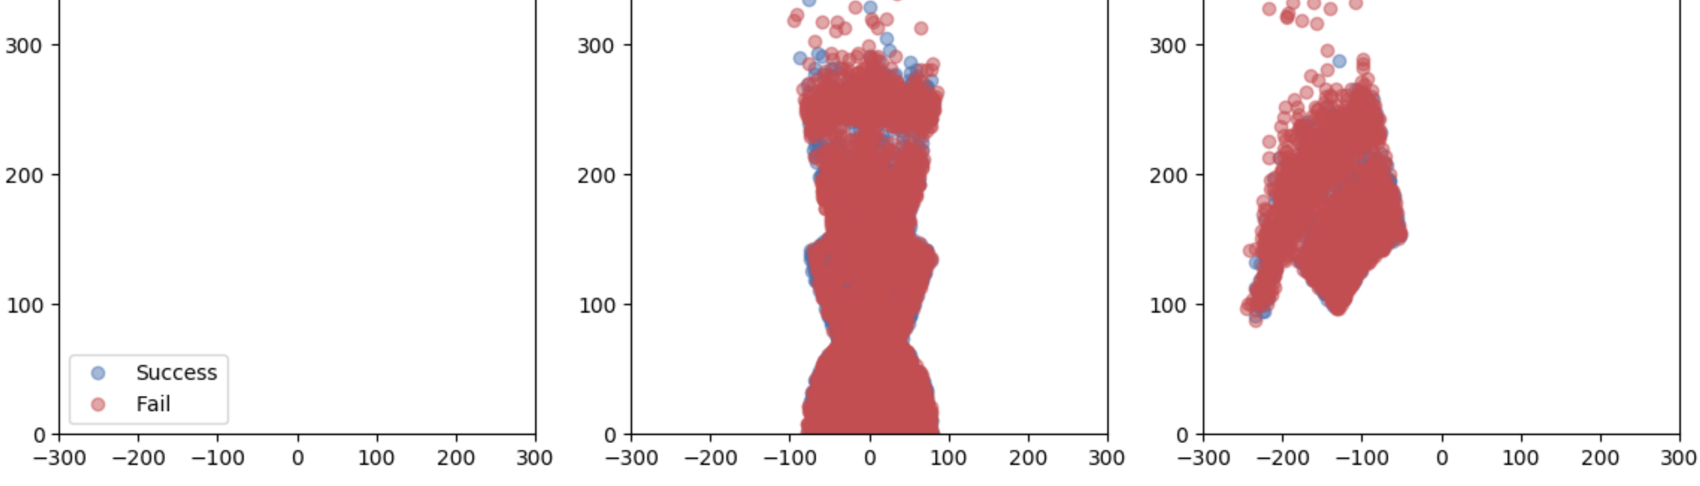
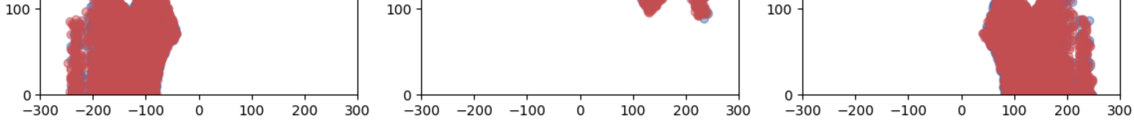
Exploring the Dataset – Part 1
More successful shots can be seen when taken at the center of the court.

Slide 14
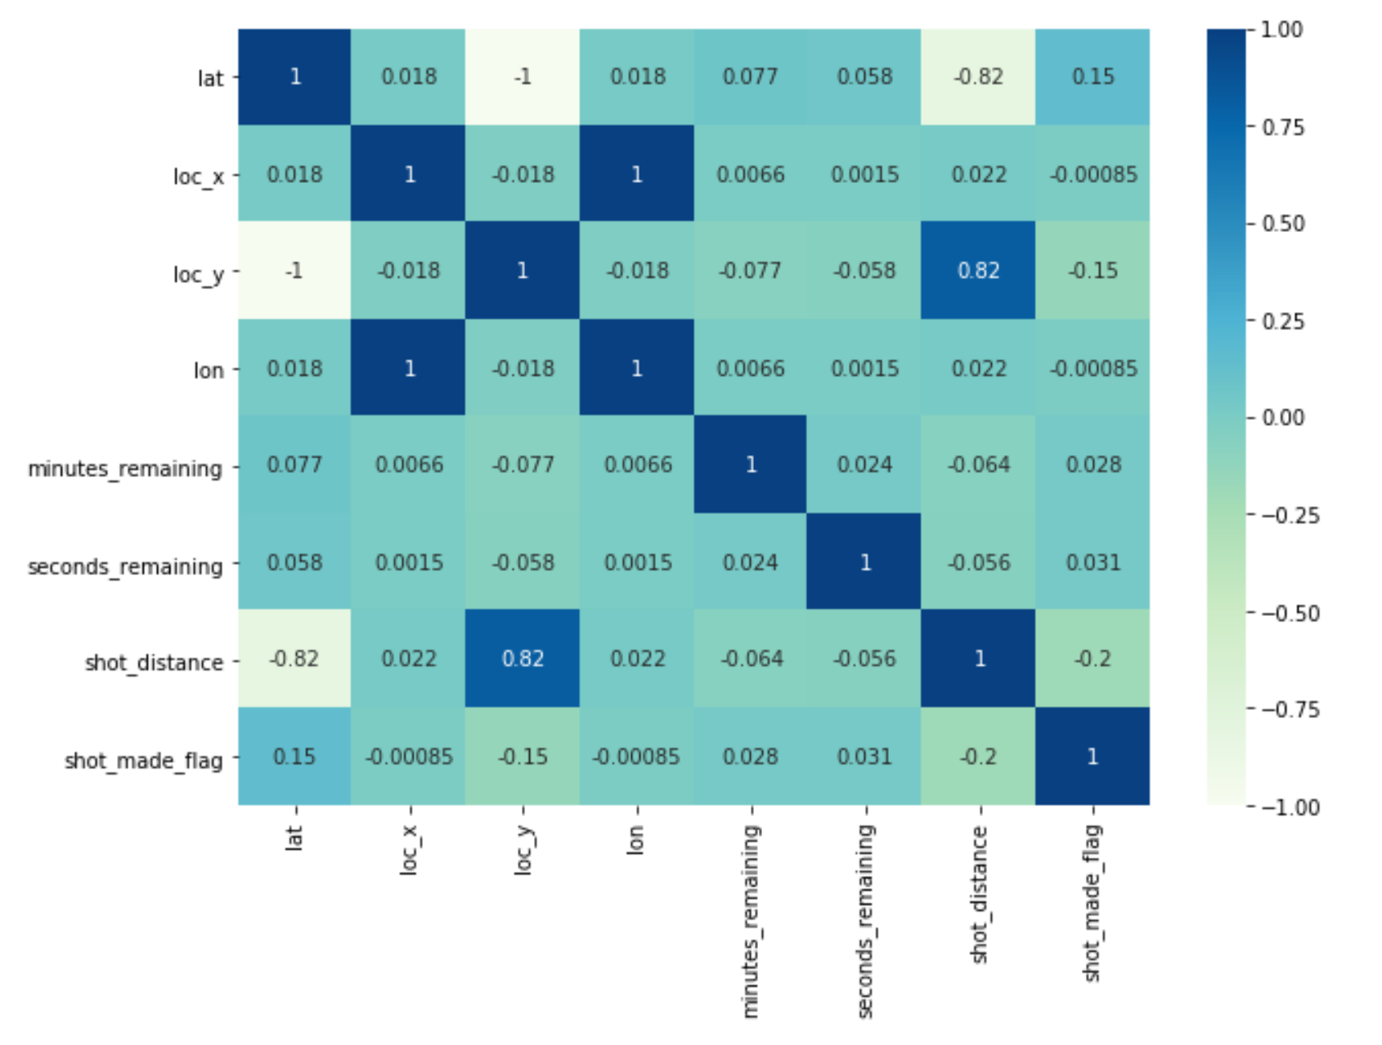
Model – Part 1
Feature Selection:
Removed highly correlated values.
lat and loc_y have a perfect negative correlation.
lon and loc_x have a perfect +ve correlation.
Shot distance is also correlated to lat and loc_y as well with a strength of -0.82 and +0.82, respectively.

Slide 15
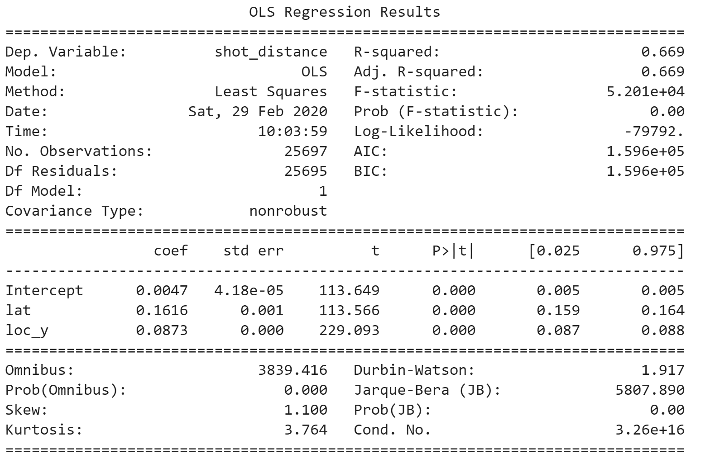
Model Part 1 – OLS Regression
Loc_y and lat explain the 66.9% of the variance in shot distance.

Slide 16
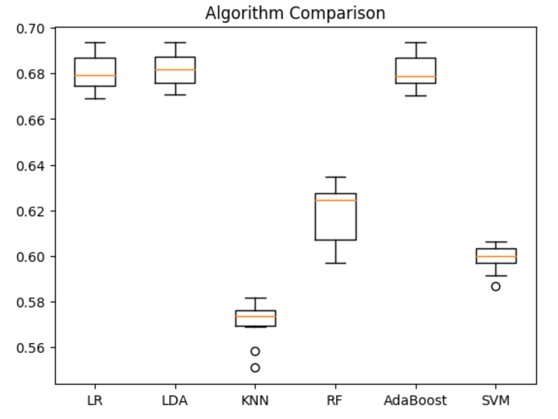
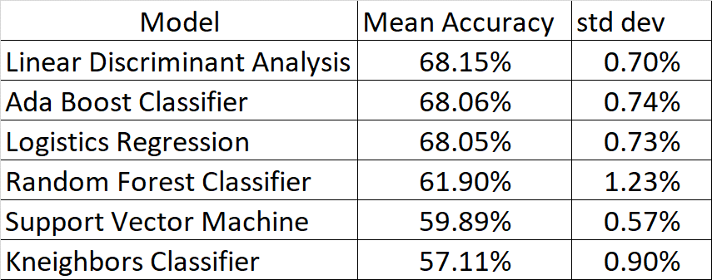
Model Part 1 – LR, LDA, KNN, RF, AdaBoost, SVM
LDA, AdaBoost and LR are the most accurate models in predicting shots.

Slide 17
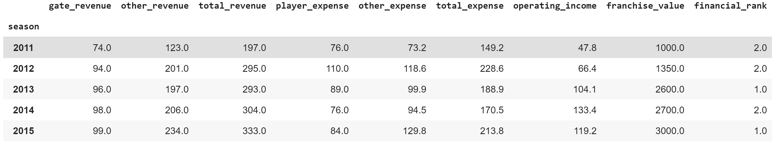
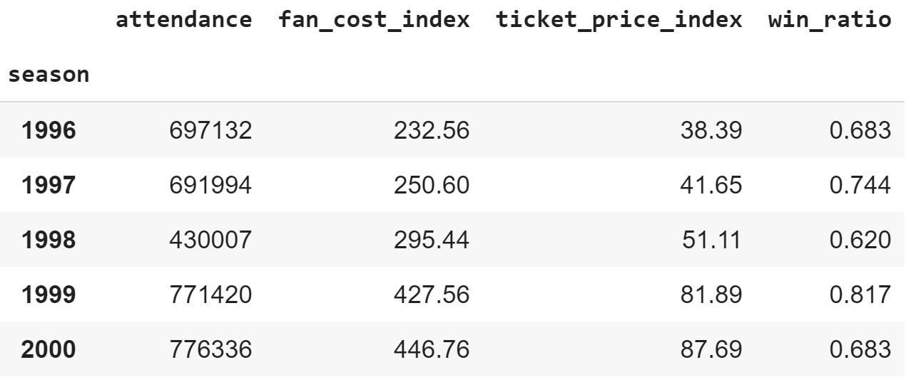
The Collection of Data – Part 2
Annual Income and Expense Data
Columns selected in the final data frame
From Rodney Fort’s sports financial data
https://sites.google.com/site/rodswebpages/codes https://drive.google.com/drive/folders/1pr_yPm9oPLcfCtWOtnrLoJdvzFDbYBAk
Lakers financial performance by year from 1996 to 2015
Annual Ticket Price and Fan Cost Data
From Rodney Fort’s sports financial data
Lakers game performance from 1996 to 2015

Slide 18
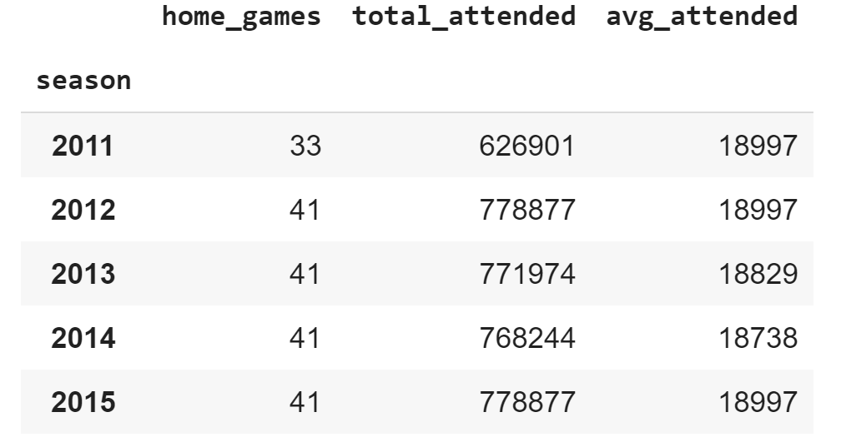
The Collection of Data – Part 2
Lakers Attendance
Columns selected in the final data frame
Data provided by the Association of Professional Basketball Research
https://www.apbr.org/attendance.html
Years covered from 1960 to 2015
Lakers Annual Record
Sourced from Sports Reference API, Robert Clark
https://sportsreference.readthedocs.io/en/stable/nba.html
Installed sportsreference and chose Lakers annual records from 1996 to 2016
Data selected:
Wins
Losses
Wins Ratio = Wins / (Wins + Losses) – Derived column

Slide 19
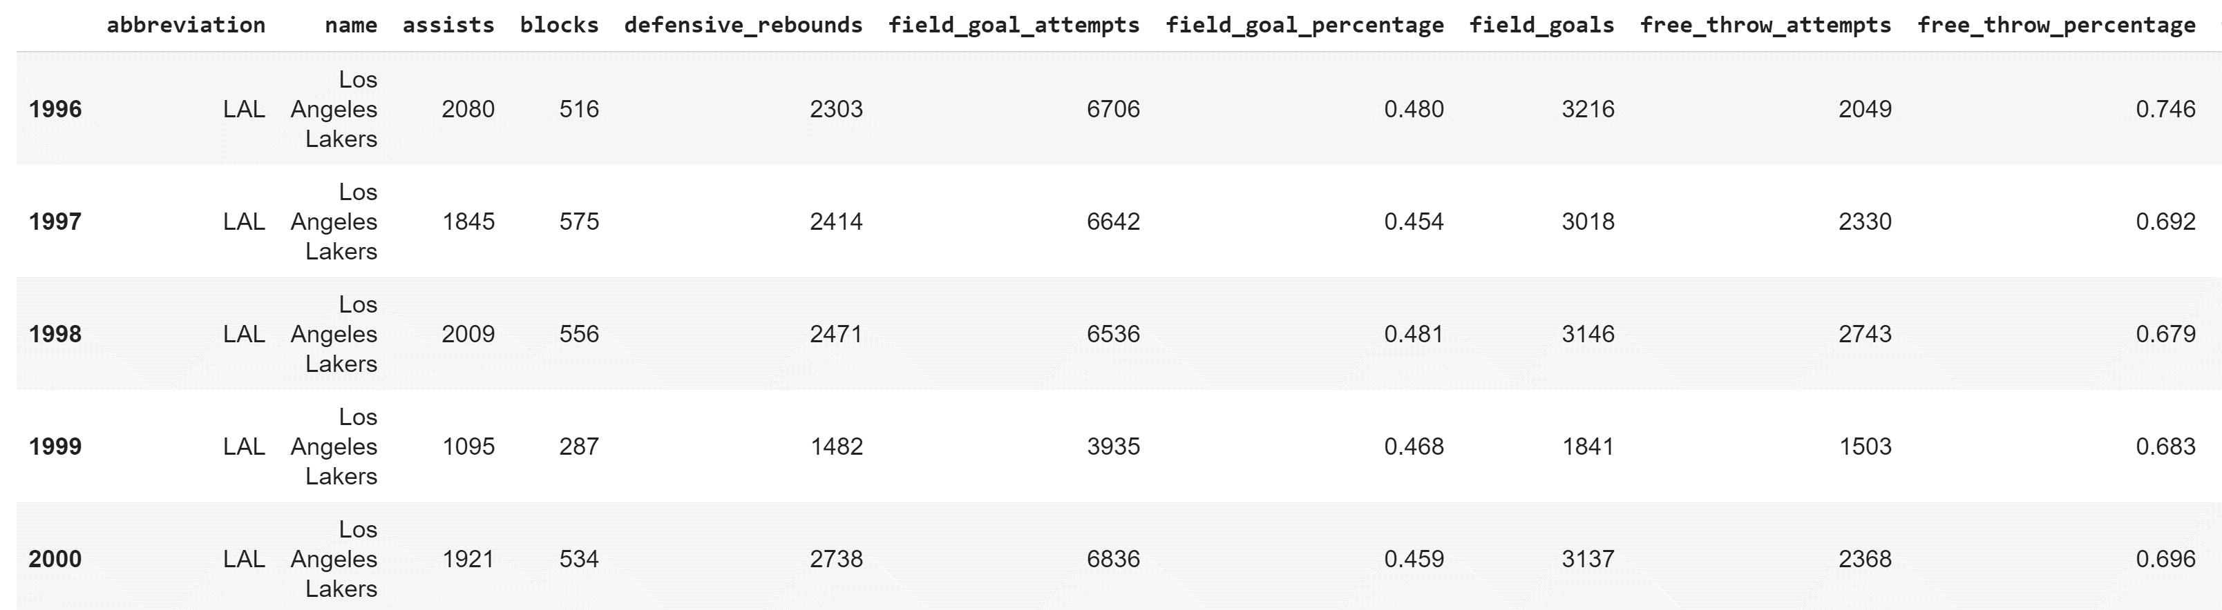
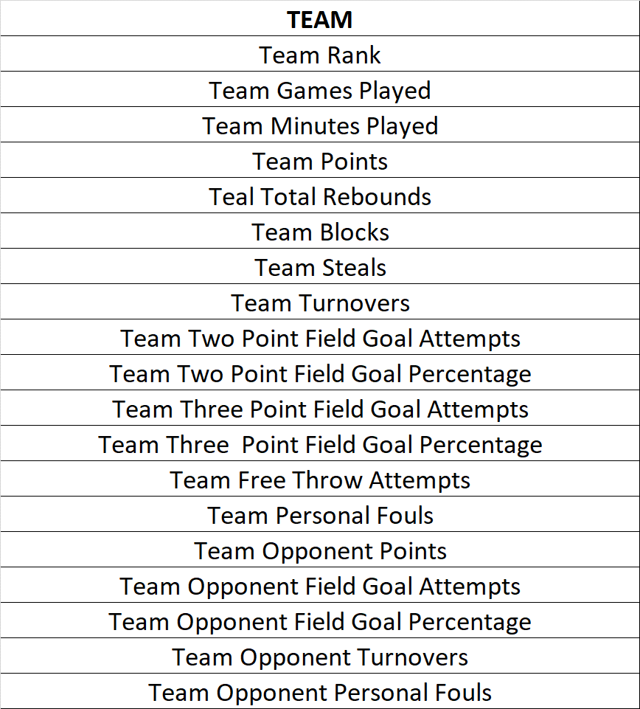
The Collection of Data – Part 2
Lakers Team Data
Data selected (excerpt):
Sourced from Sports Reference API, Robert Clark
https://sportsreference.readthedocs.io/en/stable/nba.html
Installed sportsreference and chose Lakers annual records from 1996 to 2016
Final data selected:

Slide 20
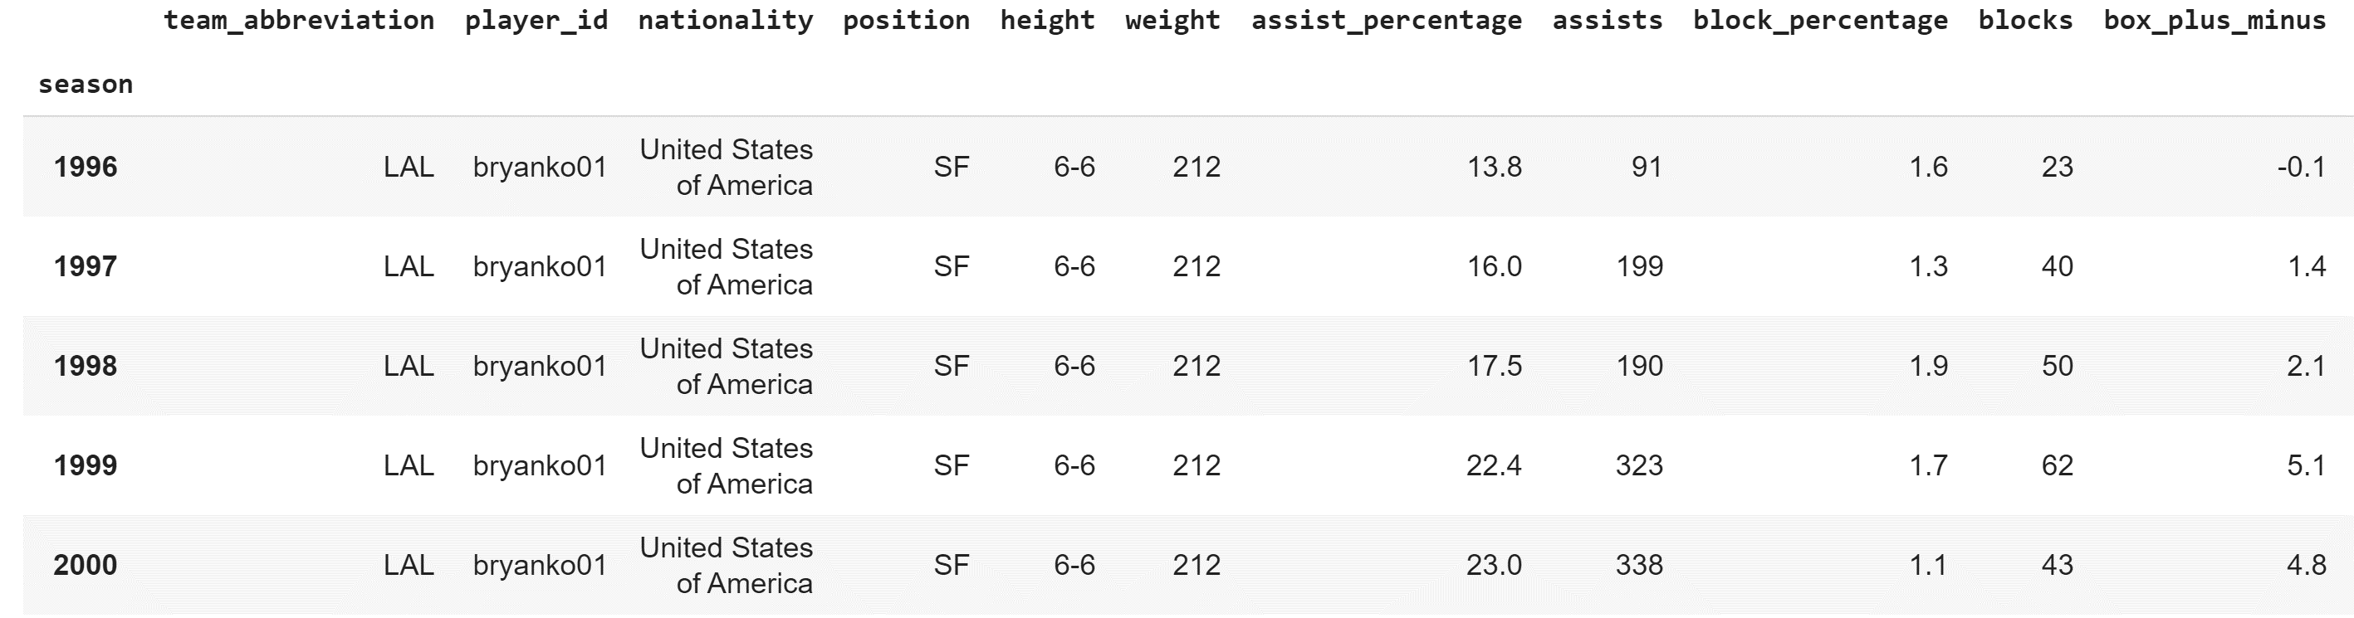
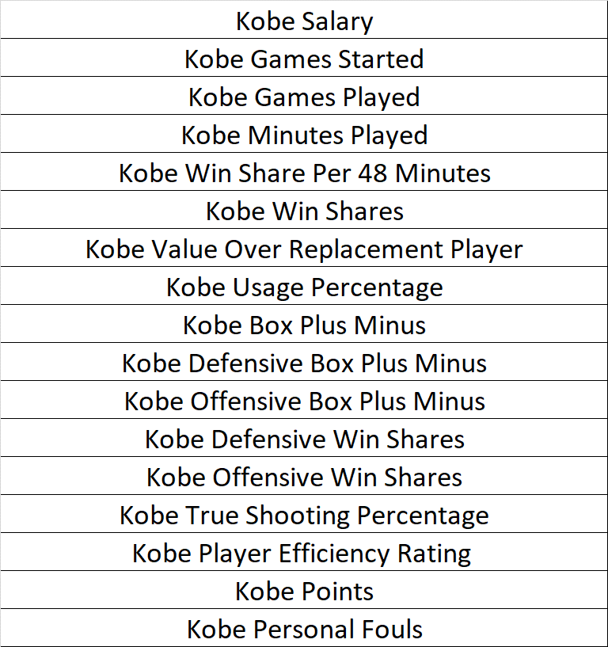
The Collection of Data – Part 2
Data selected (excerpt):
Player’s Career Data – Kobe Bryant Data
From sportsreference.nba.roster import Player
Selected player, “bryanko01” to extract Kobe’s statistics
Final data selected:

Slide 21
Pre-Processing and Data Cleaning – Part 2
Combined all relevant team, and Kobe data through merge function
Operating income and franchise value
Fan cost and ticket price index
Attendance
Record (wins, losses, wins ratio)
Team data (team statistics)
Kobe data (Kobe’s statistics including his salary)
Generated a normalized data frame to be used for some analyses

Slide 22
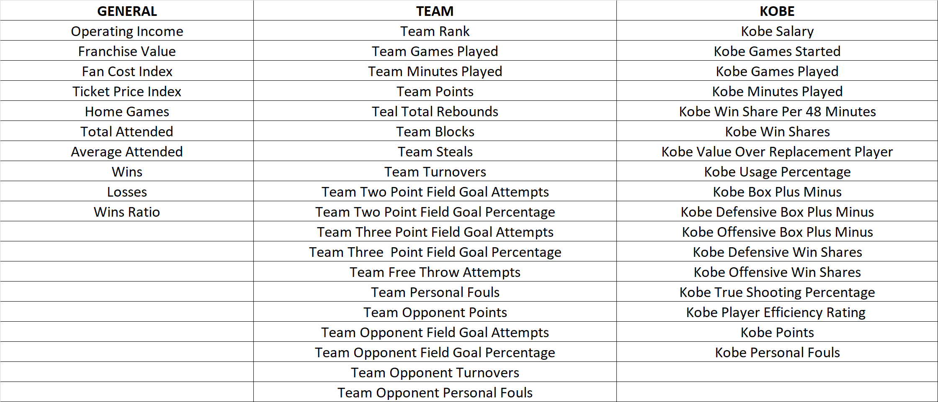
Pre-Processing and Data Cleaning – Part 2
Final Data Frame

Slide 23
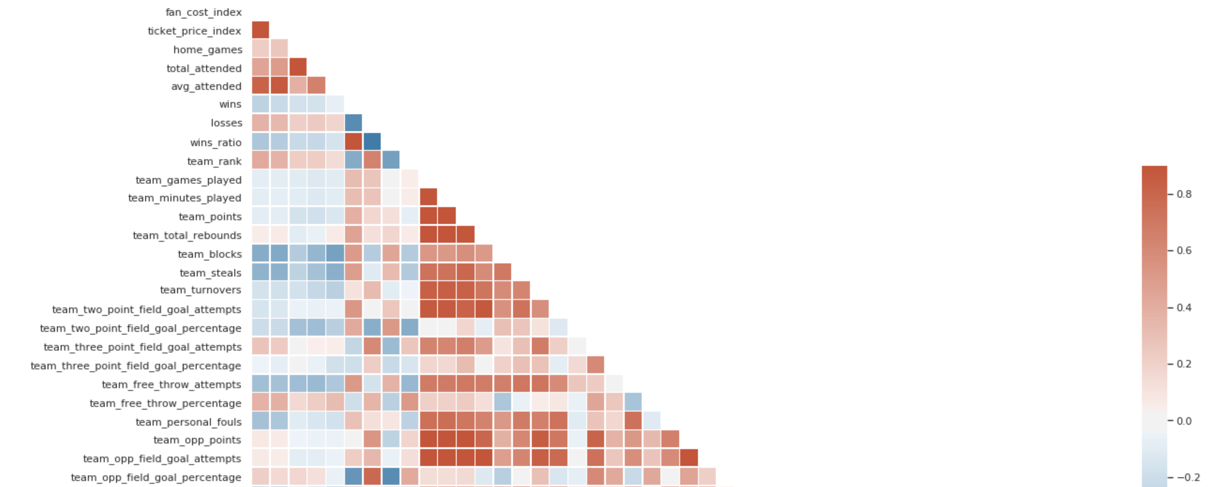
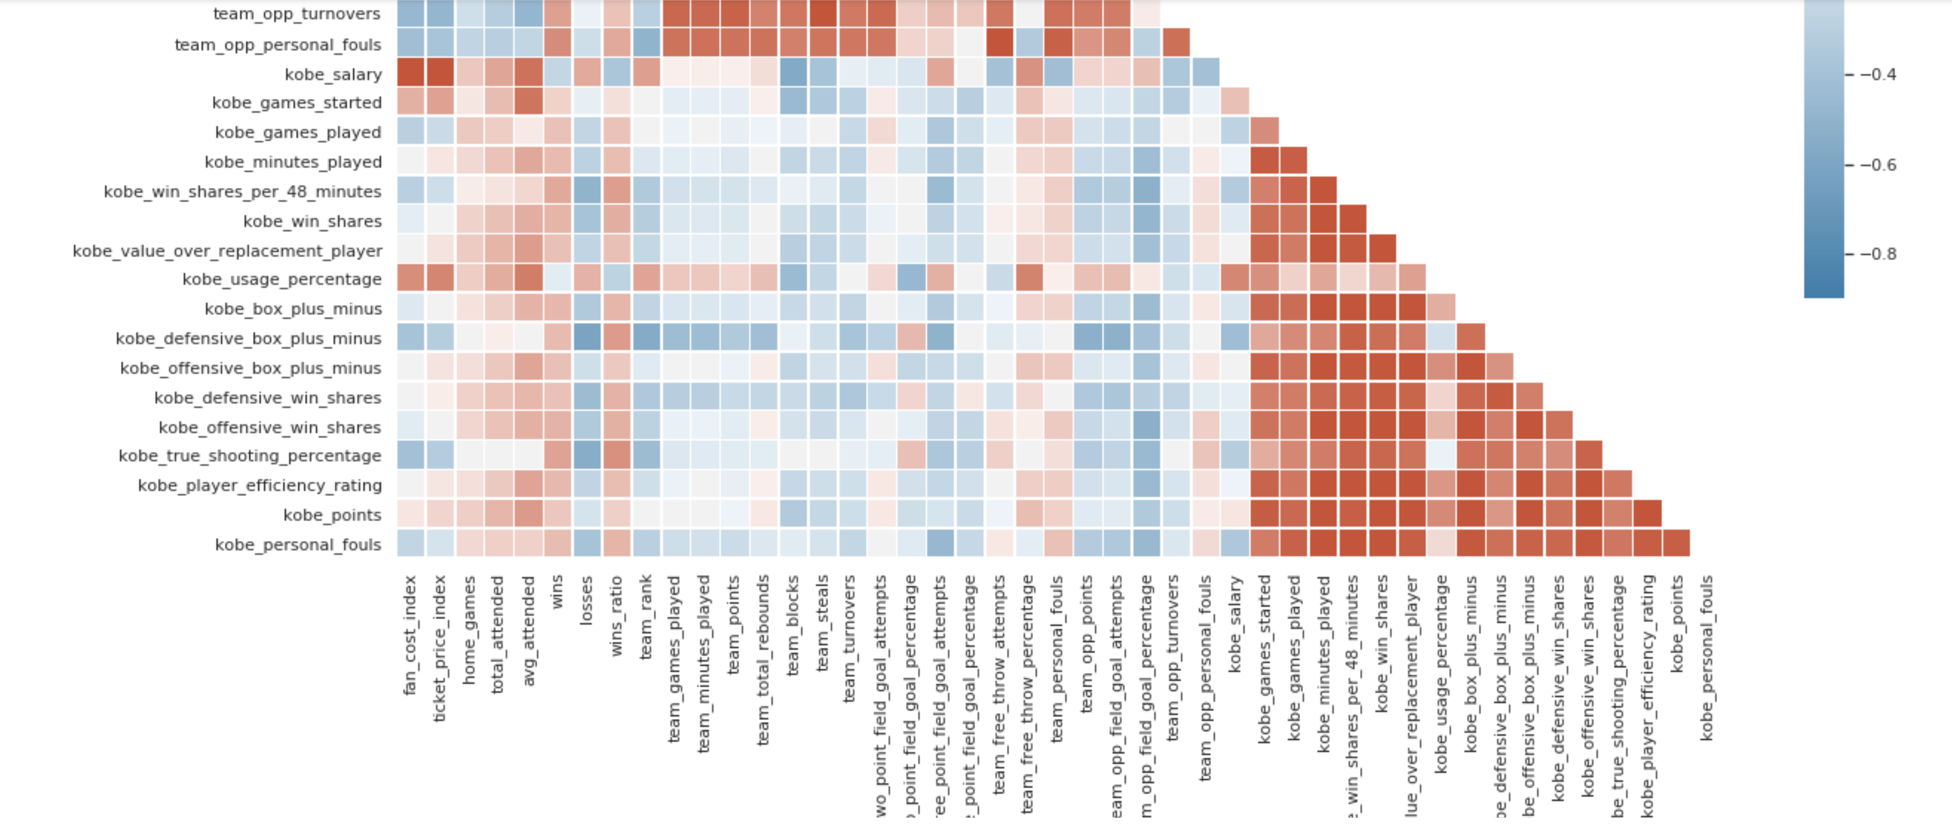
Exploring the Dataset – Part 2
The team performance are correlated with itself and not with Kobe’s.
Ticket prices and general fan costs are positively correlated with Kobe’s salary.
Opponent’s field goal % is closely correlated with Lakers’ wins and losses.
Ave attendance is slightly negatively correlated with team blocks and slightly positively correlated with Kobe’s games played.
Team
Kobe

Slide 24
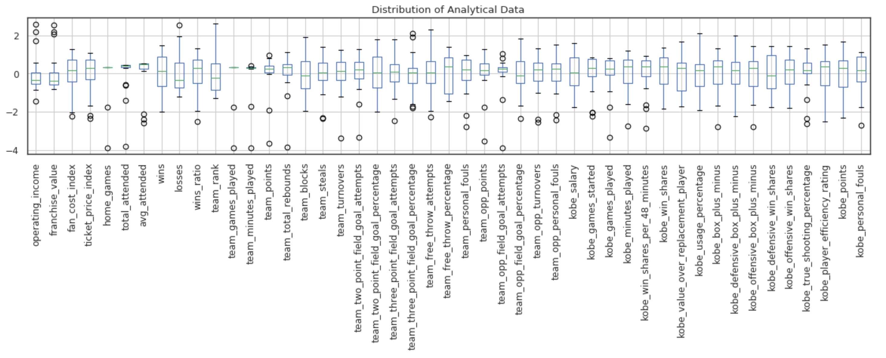
Exploring the Dataset – Part 2
GENERAL
TEAM
KOBE
- Most team performance are normally distributed except for personal fouls and free throw percentage.
- Ticket price and fan cost indices are negatively skewed, but attendance varies only slightly throughout time.
- Most of the Lakers final ranking are on the lower side outside of some good years.
- Kobe’s statistics are all relatively normally distributed expect for personal fouls, that are negatively skewed.
- All aggregate measures of Kobe’s performance show positive results for most of his career.

Slide 25
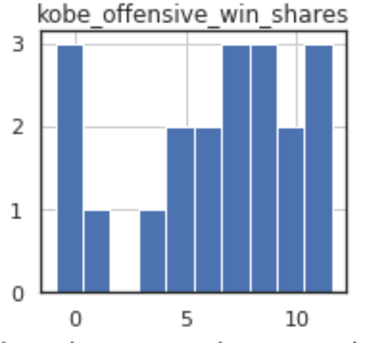
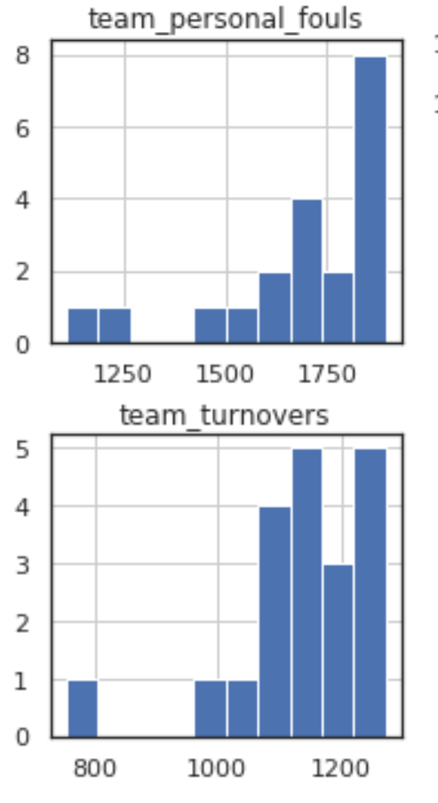
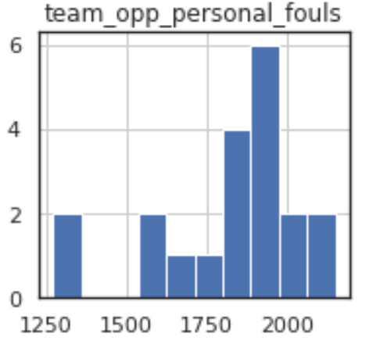
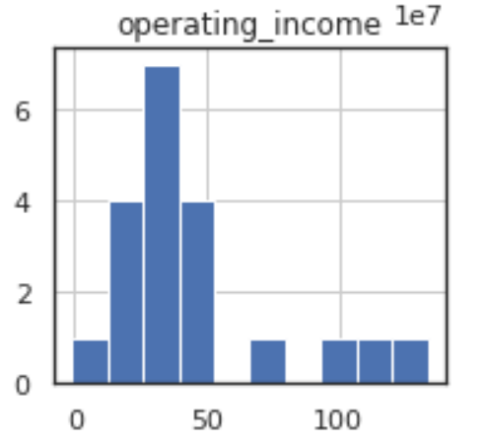
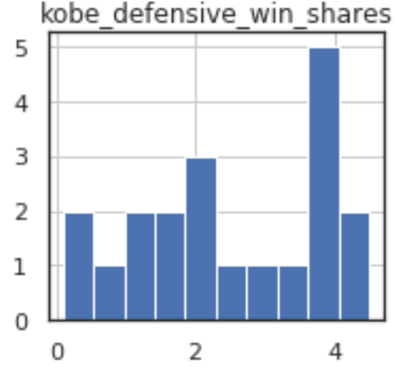
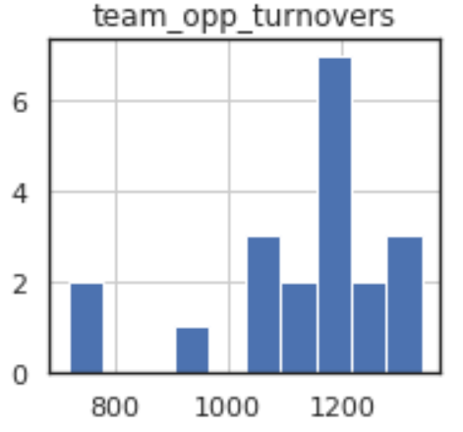
Exploring the Dataset – Part 2
Kobe appears to have a stronger offensive win shares rate than defensive win shares rate.
Operating income centralizes between $0 to $50M during most years except for four high years.
Team personal fouls and turnovers are negatively skewed, more so than their opponents.

Slide 26
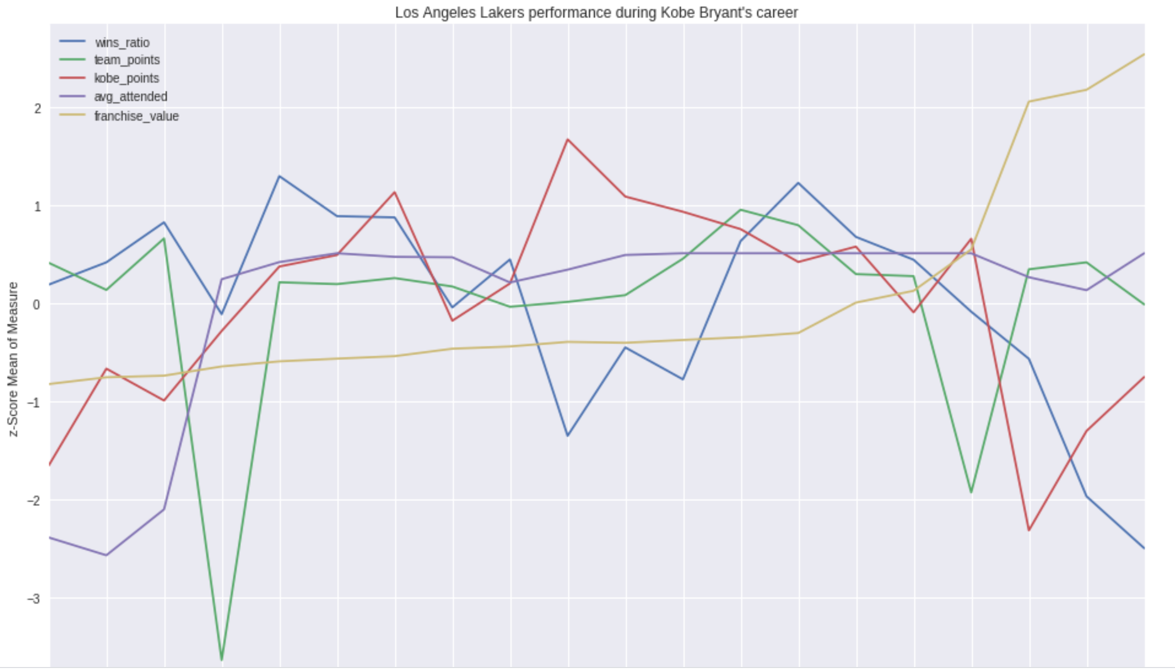
Exploring the Dataset – Part 2
Franchise value
Team wins fell off sharply toward the end of Kobe’s career, more often from his injuries.
Franchise value unrelated to all other measures.
Kobe’s points were inverted from team points in at least 2 periods at a time.
Attendance grew sharply with the opening of Staples Center, and held flat throughout Kobe’s career.
Staples Center opened in 1999 with a capacity of 19k
Kobe points
Team points

Slide 27
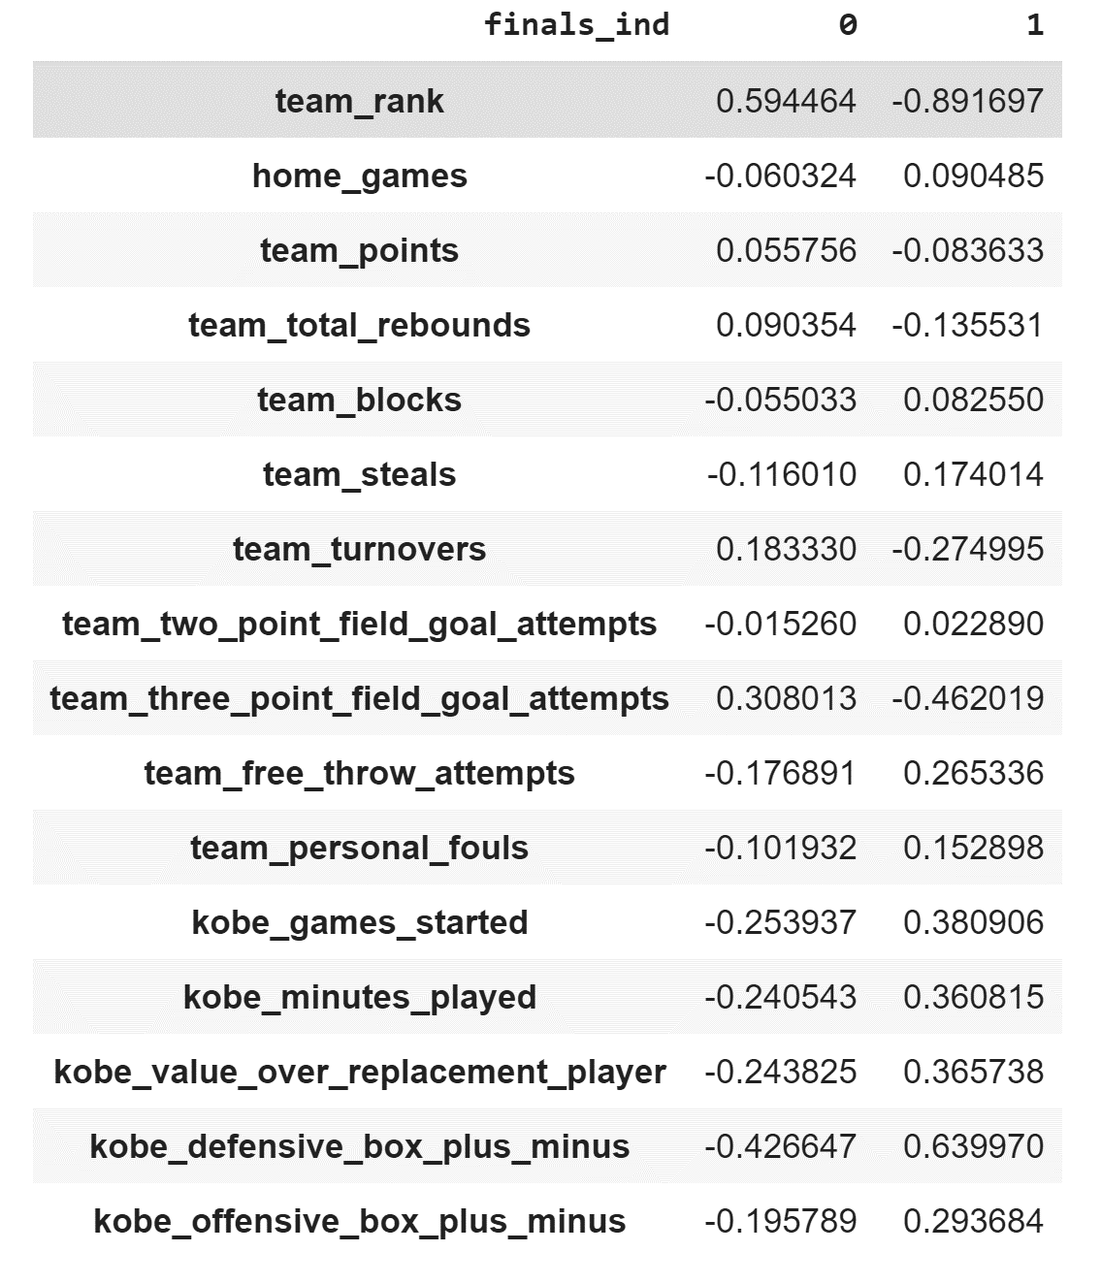
Exploring the Dataset – Part 2
Data Source: Final dataframe – Part 2
1 – Made it to Top 4
Lakers defense appeared to be most prominent when they achieved a final 4 finish.
Kobe’s measures are generally more polarizing than team performance.

Slide 28
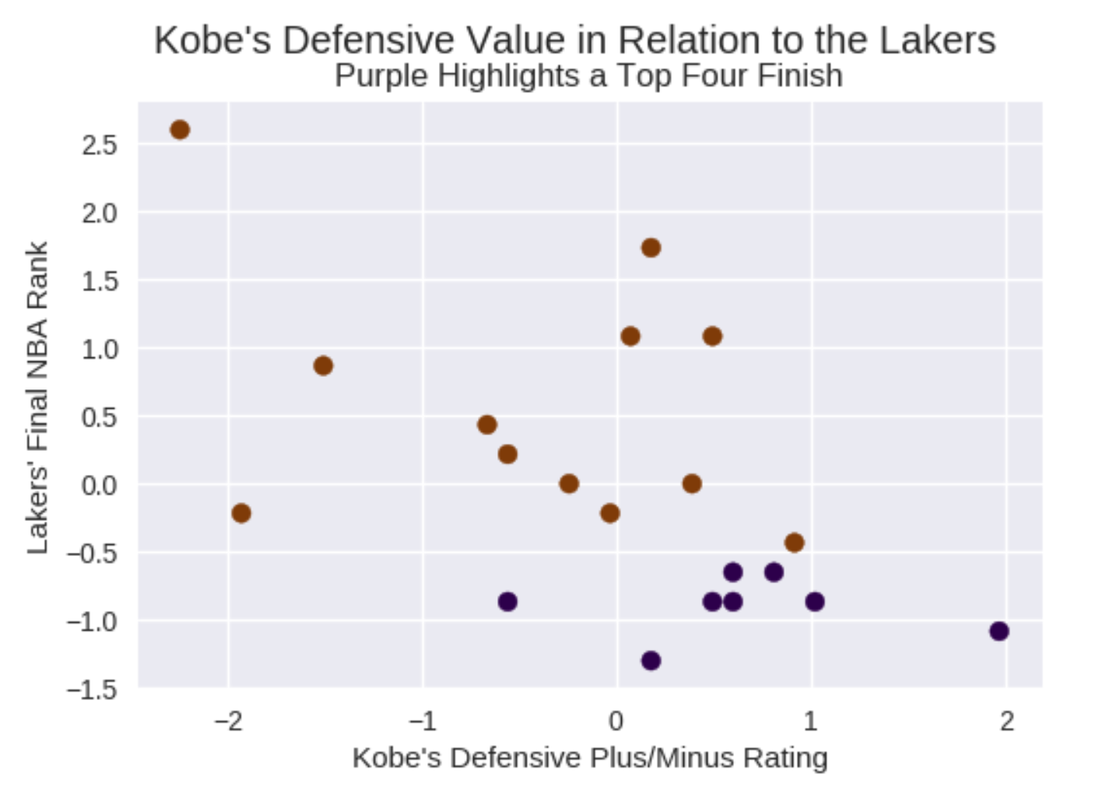
Exploring the Dataset – Part 2
The visual illustrates Kobe’s defensive performance as it relates to more or less team wins.
Top 4 Finish

Slide 29
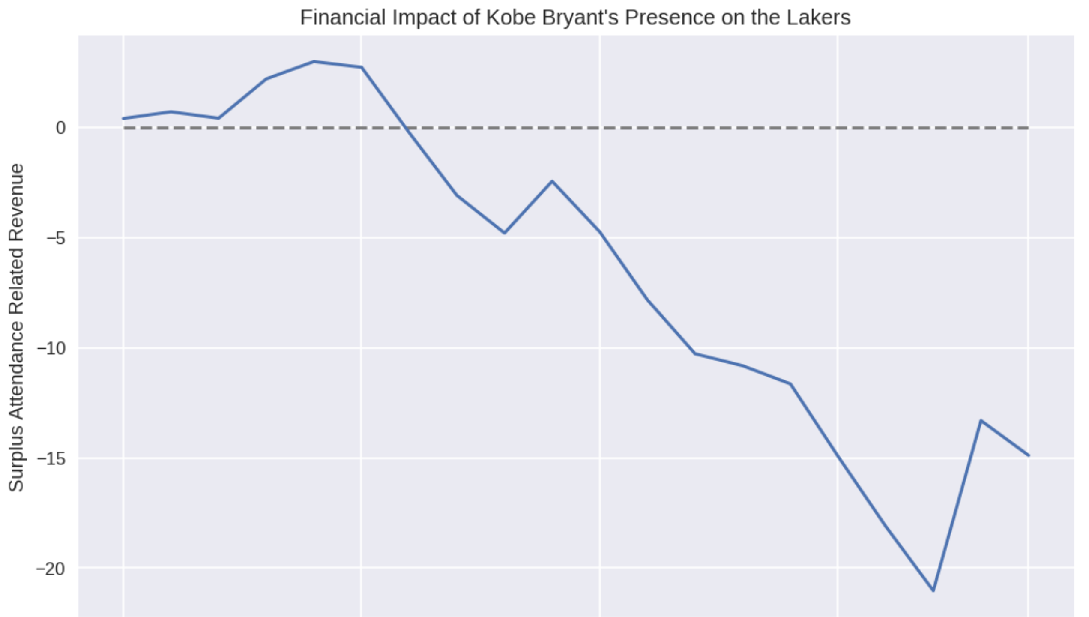
Exploring the Dataset – Part 2
Million USD
$3M
Assessing the financial impact of Kobe’s career is calculated as the difference in ticket and reduced by Kobe’s salary.
Net gain for Lakers between 1996 & 2002, then declining through the end of Kobe’s career as his salary increases.
Kobe created a surplus of $3M during 2000 – 2001 season, winning the NBA championship.
Kobe’s salary increased over time

Slide 30
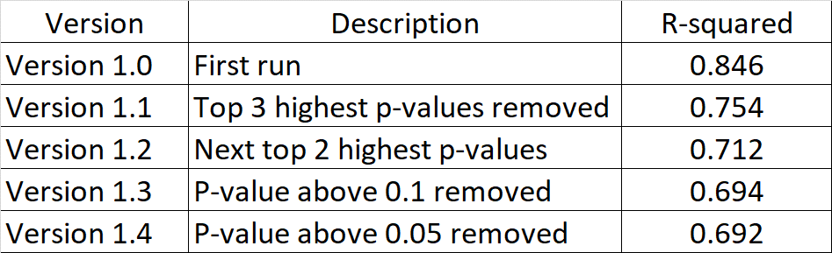
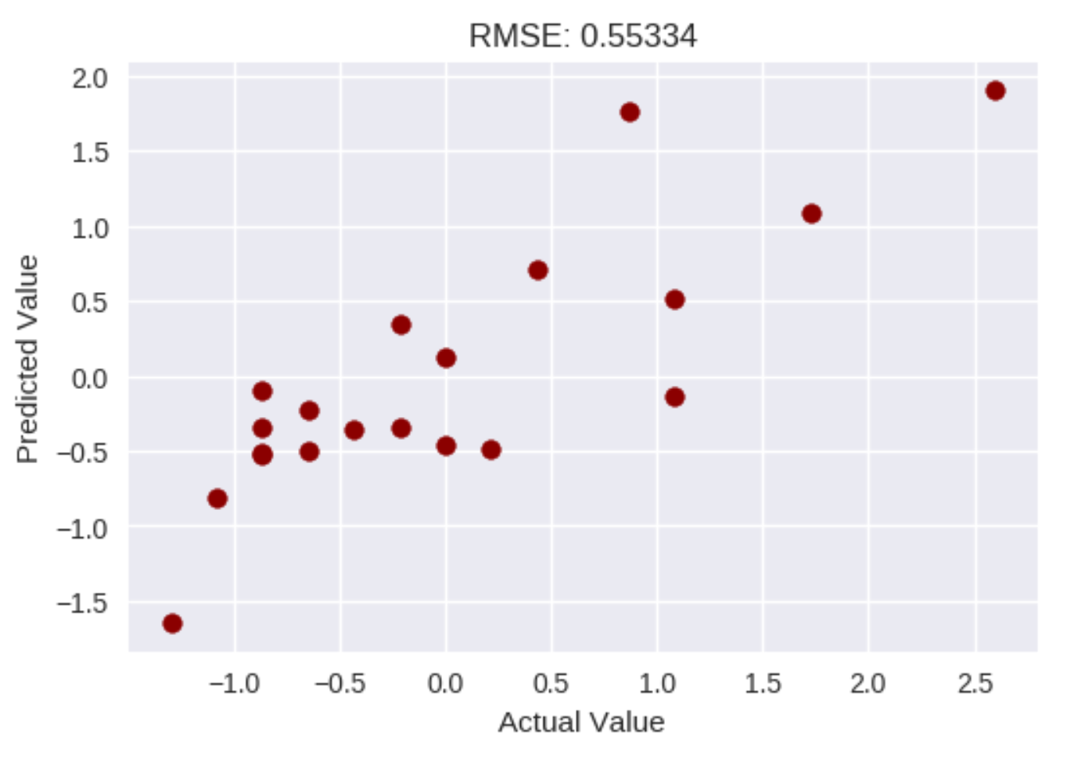
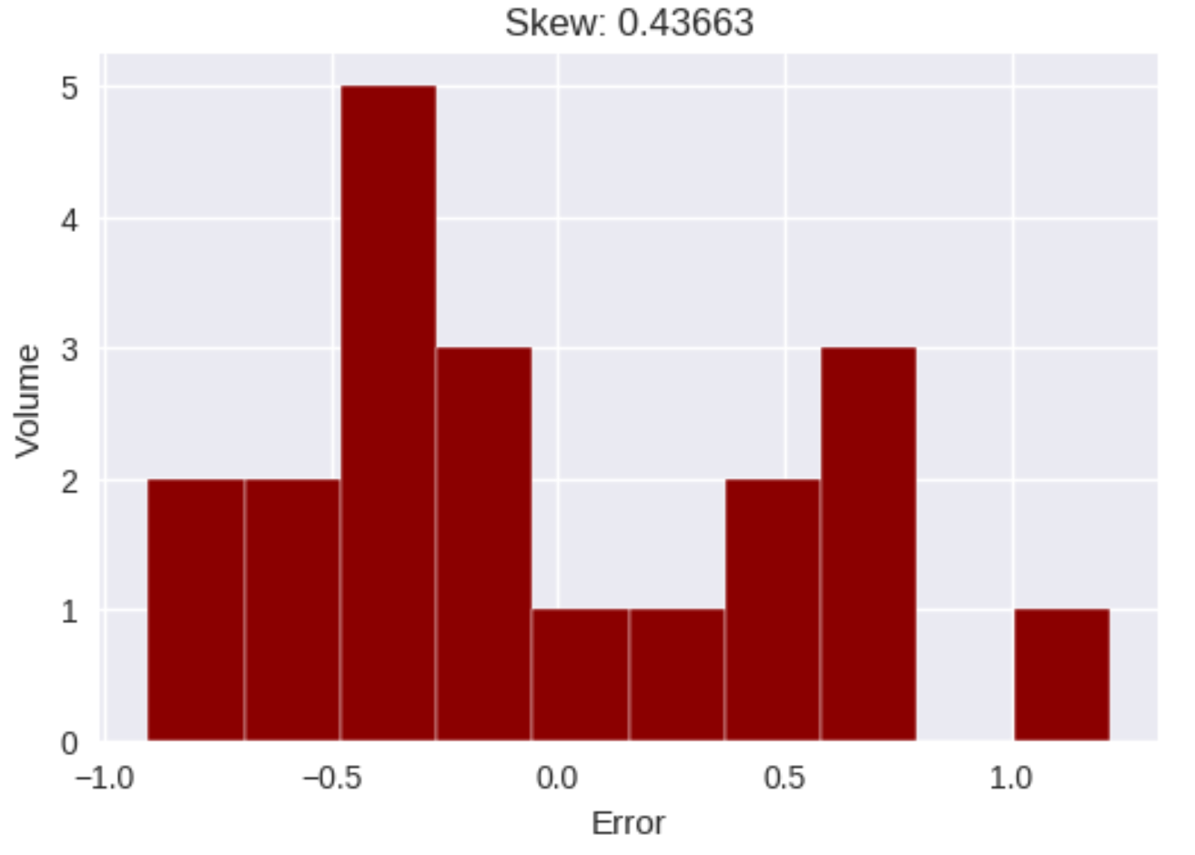
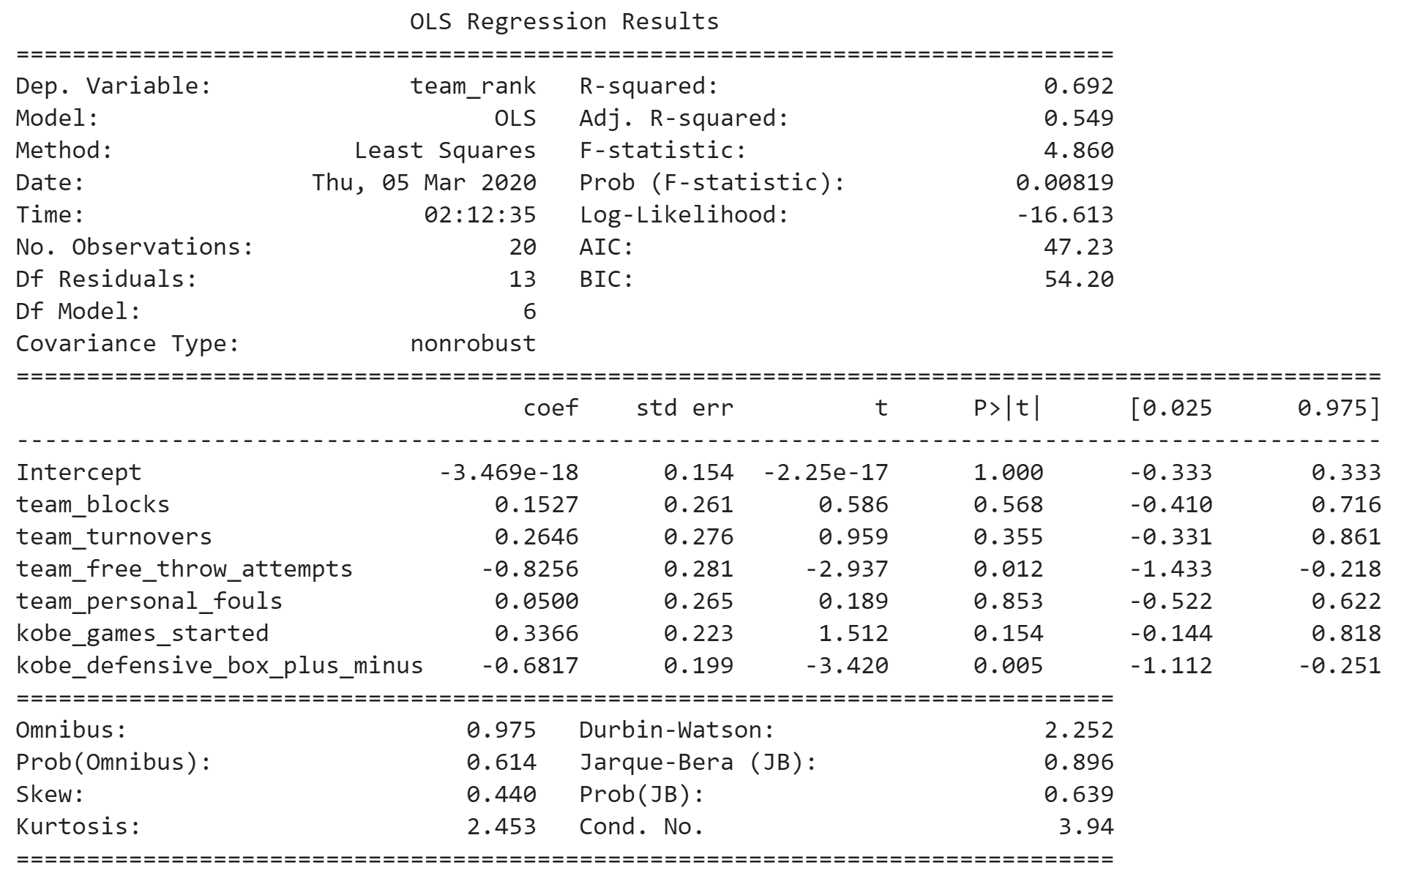
Model – OLS Regression – Part 2
Version 1.4:
Linear relationship exists between Kobe’s and the Lakers performance and the final NBA ranking.
Team Free Throw Attempts and Kobe’s Defensive Plus or Minus Ratio are the strongest predictors.
Model underpredicts by approximately half of a std dev.
RMSE is bimodal with a higher propensity to predict a better than actual rank.

Slide 31
Kobe’s jump shots with majority of the shots only had 39% success rate, while dunk had the highest success rate at 93%.
Shot were more successful when executed from the center of the court.
Ticket prices and general fans costs were positively correlated with Kobe’s salary.
Attendance grew sharply with the opening of Staples Center, and held flat throughout Kobe’s career.
Kobe created a “surplus” of $3M during 2000 – 2001 season, winning the NBA championship.
The surplus Kobe created started to decline in Y2002 until his retirement, but Lakers franchise value started to increase in Y2010.
Conclusion

Slide 32
Explore the upward trend of the franchise value after Y2010 .
Comparison of his statistics and impact to team’s profitability as compared to other basketball legends and teams (e.g. Michael Jordan, LeBron James, 1980 Detroit Pistons, etc.).
Extrapolate on how a weighted shot has an impact to overall team win as compared to other measurements.
Kobe’s defensive winning style as compared to other player’s style in winning a game.
Recommendations

